Slide 1
Reopening Massachusetts
May 18, 2020

Slide 2
THE ROAD WE'VE TRAVELLED TOGETHER
March 10
State of Emergency
declared
March 14
COVID-19 Command Center established
March 23
Non-essential businesses closed
April 28
Business closures extended
May 18th
Reopening announcement
Massachusetts has been one of the hardest hit states in the U.S., with over 86,000 confirmed cases and 5,700 deaths through May 17, 2020.
On March 23, 2020 Governor Baker issued an executive order closing all non-essential businesses across the Commonwealth in order to reduce the transmission of COVID-19.
In combatting COVID-19, the Baker-Polito administration has:
In partnership with healthcare providers and municipalities, conducted more than 460,000 COVID-19 tests, making Massachusetts a top-5 per capita tester
Launched a national model for contact tracing
Committed over $1 billion in funding to support our health care system
Distributed more than 10.5 million pieces of personal protective equipment
Number of confirmed COVID-19 cases,
per 100k population (thousands)
As of 5/12/2020
New York
1.7
New Jersey
1.6
Massachusetts
1.1
Rhode Island
1.1
Connecticut
1.0
District of Columbia
0.9
Delaware
0.7
Louisiana
0.7
Illinois
0.7
Maryland
0.6
US Average
REOPENING MASSACHUSETTS

Slide 3










































































GETTING STARTED ON THE PATH TO REOPENING
On April 28, Governor Baker formed the Reopening Advisory Board, chaired by Lieutenant Governor Karyn Polito and Secretary of Housing and Economic Development Mike Kennealy, and comprised of representatives from the business community, public health officials, and municipal leaders from across the Commonwealth.
In crafting this report, the Reopening Advisory Board and other state officials:
Heard testimony from more than 75 business associations, labor unions, non-profits, and community coalitions that collectively represent more than 112,000 businesses and more than 2,000,000 employees
Received and reviewed more than 4,600 written submissions from associations, businesses, and residents
Engaged stakeholders and analyzed information in over 45 hours of Zoom meetings over the past 20 days
REOPENING MASSACHUSETTS

Slide 4
WORKING TOGETHER TO REOPEN
Until a treatment or vaccine for COVID-19 is available, life will not return to normal. We each have a collective responsibility to ensure that reopening proceeds smoothly and safely. Everyone must follow public health directives and use common sense to protect yourself, your family, your neighbors, and vulnerable populations across the Commonwealth.
Individuals
  Cover your face
  Wash your hands
  Socially distance
  Be vigilant for symptoms
  Stay home if you feel sick
Employers
Set business practices that adhere to the Mandatory Workplace Safety Standards and Sector-Specific Protocols for your industry
Working Together to Reopen
Employees
Abide by employer practices that adhere to the mandatory safety standards and sector specific protocols
Government
  Set standards in the interest of public health
  Invest in necessary capabilities
  Communicate to and educate the public
  Regularly track and report COVID-19 data
  Expand testing capacity
Health system
Monitor progression to ensure sufficient system capacity to meet needs
REOPENING MASSACHUSETTS

Slide 5
REOPENING WILL BE DRIVEN BY PUBLIC HEALTH DATA
% decrease from 4/15
Key public health metrics will determine if and when it is appropriate to proceed through reopening phases
Public health data trends indicating significant increases in viral transmission could result in returning to prior phases or closing sectors of the economy
63
7-day avg. of positive test results, by date patient tested (%)
4.0
3.7
25
3-day avg. of hospitalizations (000s)
3.6
3.6
3.6
3.5
3.5
3.4
3.5
3.3
3.2
3.2
3.1
3.1
3.0
2.9
3.0
2.8
2.7
2.5
# hospitals using ICU surge
capacity
14
200
35
3 day average of deaths by date of death (#)
175
150
125
100
Source: MA COVID Command Center, May 2020
5/1
5/2
5/3
5/4
5/5
5/6
5/7
5/8
5/9
5/10
5/11
5/12
5/13
5/14
5/15
5/16
5/17
REOPENING MASSACHUSETTS

Slide 6
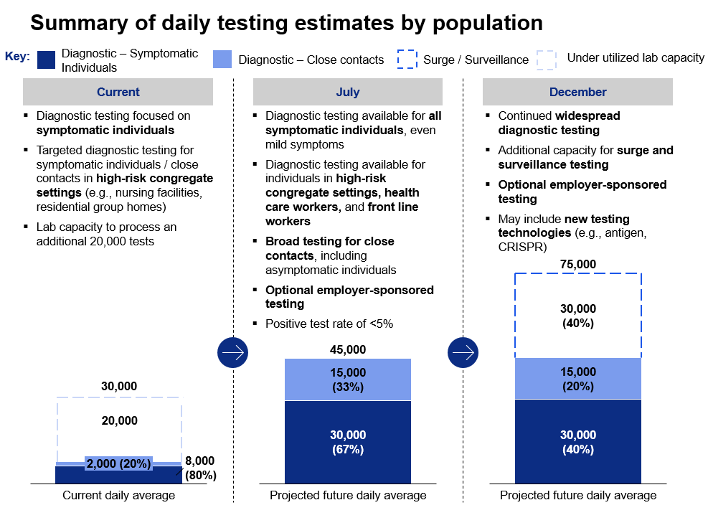
MASSACHUSETTS TESTING & TRACING STRATEGY
Test: Increase testing capacity and number of people tested so people with COVID-19 are aware of their diagnosis and can self-isolate
Trace: Trace all contacts of people with COVID-19 to ensure safe quarantine and testing for those who need it
Isolate: Minimize transmission by isolating and quarantining individuals with COVID-19 and their close contacts
Support: Provide support so individuals can safely isolate and quarantine
REOPENING MASSACHUSETTS

Slide 7
REOPENING WILL BE DRIVEN BY PUBLIC HEALTH DATA
Dashboard of public health indicators
Starting on May 18, the COVID-19 Command Center will give updates on six key public health indicators
Before and during reopening, these metrics must continue to show progress
Below is the status as of May 18, 2020:
Indicator |  | Status
 | COVID-19 positive test rate
 | Number of individuals who died from COVID-19
 | Number of patients with COVID-19 in hospitals
 | Healthcare system readiness
 | Testing capacity
 | Contact tracing capabilities
1
2
3
Legend
4
Positive trend
5
In progress
6
Negative trend
REOPENING MASSACHUSETTS

Slide 8
REOPENING AND FIGHTING COVID-19
As we reopen the Massachusetts economy, the Baker-Polito administration will provide guidance that each sector, industry, and business must follow:
Social guidance
Business guidance
General social guidance
Guidance all individuals must follow to reduce the risk of new COVID-19 transmission:
Cover your face
Wash your hands
Socially distance
Be vigilant for symptoms
Stay home if you feel sick
Mandatory Workplace Safety Standards
New standards for all workplaces that are designed to reduce the risk of new COVID-19 transmission to employees and customers
Sector-Specific Protocols and best practices
Additional safety standards and recommended best practices to reduce the risk of new COVID-19 transmission in specific industries (e.g. restaurants, construction, etc.)
REOPENING MASSACHUSETTS

Slide 9
REOPENING AND FIGHTING COVID-19
On May 18, the Baker-Polito administration issued the Safer At Home Advisory:
Cover – Wash – Distance – Vigilance
What Safer At Home Means
Only leave home for health care, permitted work, shopping, and outdoor activities
When going to the pharmacy ask if you can fill your prescriptions for 90 days if possible; for some medications this is not allowed. If you are at high-risk, try to use a mail-order service
Don’t participate in close contact activities such as pick-up sports games
Use remote modes of communication like phone or video chat instead of visiting friends or family who are high risk for COVID-19
Refrain from visiting nursing homes, skilled nursing facilities, or other residential care settings
Parents should limit play dates for children
People over the age of 65 and people who have underlying health conditions – who are at high risk for COVID-19 – should continue to stay home except for essential errands such as going to the grocery store and to attend to healthcare needs
All residents are advised to leave home only for healthcare, worship and permitted work, shopping, and outdoor activities
All residents are REQUIRED to cover their face when they cannot maintain six feet of social distance in public
All residents are advised to wash their hands frequently for at least 20 seconds with soapy water
All residents are advised to be vigilant, monitor for symptoms and stay home if you feel sick
REOPENING MASSACHUSETTS

Slide 10
REOPENING AND FIGHTING COVID-19
Mandatory Workplace Safety Standards for reopening
All businesses and activities, as they reopen, must meet the following minimum safety standards:
Social Distancing | All persons, including employees, customers, and vendors should remain at least six feet apart to the greatest extent possible, both inside and outside workplaces Establish protocols to ensure that employees can practice adequate social distancing Provide signage for safe social distancing Require face coverings or masks for all employees
Hygiene Protocols | Provide hand washing capabilities throughout the workplace Ensure frequent hand washing and ensure adequate supplies Provide regular sanitization of high touch areas, such as workstations, equipment, screens, doorknobs, restrooms throughout work site
Staffing and Operations | Provide training for employees regarding the social distancing and hygiene protocols Employees who are displaying COVID-19-like symptoms do not report to work Establish a plan for employees getting ill from COVID-19 at work, and a return-to-work plan
Cleaning and Disinfecting | Establish and maintain cleaning protocols specific to the business When an active employee is diagnosed with COVID-19, cleaning and disinfecting must be performed Disinfection of all common surfaces must take place at intervals appropriate to said workplace
Note: Businesses operating to provide Essential Services, as defined in the Governor's March 23, 2020 Executive Order, updated on March 31, April 28 and May 15, may remain open and have until May 25, 2020 to comply with these mandatory safety standards.
REOPENING MASSACHUSETTS

Slide 11
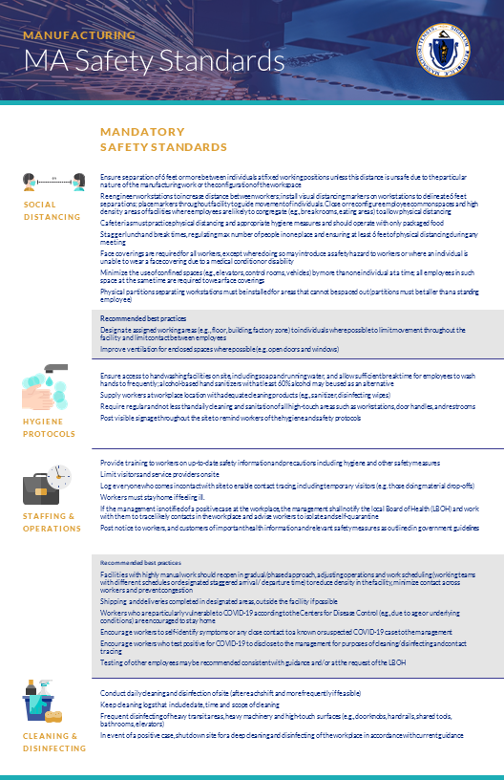
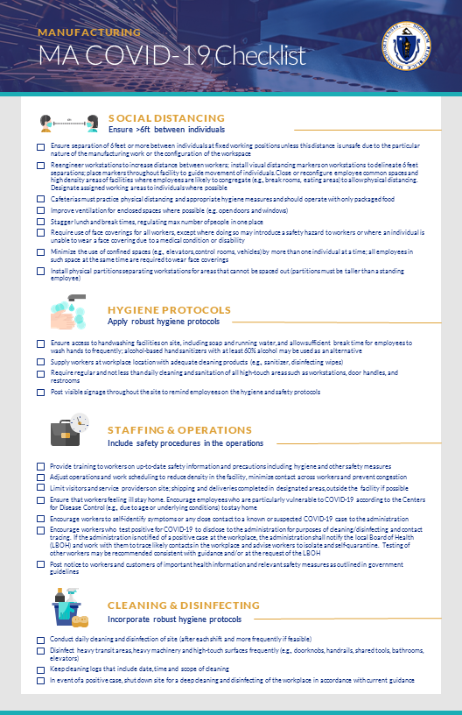
REOPENING AND FIGHTING COVID-19
Sector-Specific Protocols and best practices
The Baker-Polito administration has developed specific guidance so that each industry reopens as safely as possible. Businesses are expected to implement these protocols in addition to the more general Mandatory Workplace Safety Standards.
As of May 18, materials for the sectors eligible to open in the first phase of reopening are included on the mass.gov/reopening. Guidance for sectors opening in later phases will be posted online in advance of those phases. Each sector will have access to:
Sector Circular
Mandatory safety standards and recommended best practices in social distancing, hygiene protocols, staffing/operations, and cleaning/disinfecting for each sector.
Sector Checklist
Checklist developed to serve as guidance for employers and businesses of all sizes as they adjust operations to address worker and customer safety.
Note: Businesses operating to provide Essential Services, as defined in the Governor's March 23, 2020 Executive Order, updated on March 31, April 28 and May 15, may remain open and have until May 25, 2020 to comply with their industry’s sector specific protocols (if applicable).
REOPENING MASSACHUSETTS

Slide 12
REOPENING MASSACHUSETTS IN PHASES
The goal of this phased reopening plan is to methodically allow businesses, services, and activities to resume, while avoiding a resurgence of COVID-19 that could overwhelm our healthcare system and erase the progress we’ve made so far.
Current state:
Stay at home
Phase 1: Start
Phase 2: Cautious
Phase 3: Vigilant
Phase 4: New normal
Essential business and services only
Limited industries resume operations with severe restrictions
Additional industries resume operations with restrictions and capacity limitations
Additional industries resume operations with guidance
Development of vaccines and / or treatments enable resumption of "new normal"
Each phase will last a minimum of three weeks and could last longer before moving to the next phase
If public health data trends are negative, specific industries, regions, and/or the entire Commonwealth may need to return to an earlier phase
The Commonwealth will partner with industries to draft Sector-Specific Protocols in advance of future phases (example: restaurant specific protocols will be drafted in advance of Phase 2)
If we all work together to defeat COVID-19, we can proceed through each phase
REOPENING MASSACHUSETTS

Slide 13
REOPENING MASSACHUSETTS IN PHASES
The Baker-Polito administration's data-driven approach to reopening the economy used a framework that considered the public health risk and the economic benefit of reopening each of the closed sectors of our economy. In addition to this framework, the Baker-Polito administration looked to what other states are doing, including our immediate neighbors and those that were similarly impacted by COVID-19.
Framework to inform which sectors should be considered for reopening in each phase:
higher
Phase 4
Public health risk
of reopening
Phase 3
Contact intensity, % of public-facing roles
Phase 2
Phase 1
Illustrative sectors
lower
higher
Economic benefit of reopening
lower
Unemployment claims, median income, % of small and medium businesses
REOPENING MASSACHUSETTS

Slide 14
REOPENING MASSACHUSETTS IN PHASES
Phased approach and reopening summary plan (I)
Current state:
Stay at home
Phase 1: Start
Phase 2: Cautious
Phase 3: Vigilant
Phase 4: New normal
Social guidance
High risk populations As defined by the CDC | High risk should work from home if possible, priority consideration for workplace accommodations | High risk should work from home if possible, priority consideration for workplace accommodations | High risk should work from home if possible, priority consideration for workplace accommodations | High risk should work from home if possible; priority consideration for workplace accommodations (these could be adjusted depending on pending epidemiological evidence) | Resume public interactions with physical distancing
Gathering size | Gatherings of <10 people | Gatherings of <10 people | To be determined based on trends | To be determined based on trends | To be determined based on trends
Travel | Stay at home advisory All travelers to MA urged to self-quarantine for 14 days Lodging restricted to essential workers only | Safer at home advisory All travelers to MA urged to self-quarantine for 14 days Lodging restricted to essential workers only | Business and recreational travel discouraged All travelers to MA urged to self-quarantine for 14 days Lodging open with restrictions | To be determined based on trends | Travel resumes, continue to observe social guidance
As residents of Massachusetts, we are all in this together. Across all phases of reopening, please:
Cover your face
Wash your hands
Socially distance
Be vigilant for symptoms
Stay home if you feel sick
Most certain
Least certain
Degree of certainty given the progression of COVID-19
REOPENING MASSACHUSETTS

Slide 15
REOPENING MASSACHUSETTS IN PHASES
Phased approach and reopening summary plan (II)
Current state:
Stay at home
Phase 1: Start
Phase 2: Cautious
Phase 3: Vigilant
Phase 4: New normal
Worship | Gathering restrictions | On May 18 open with guidelines, outdoor services are encouraged | Open with updated guidelines, outdoor services are encouraged | Open with updated guidelines, outdoor services are encouraged | Full resumption of activity in the "new normal"
Business | Essential businesses only (Remain open across all phases with guidelines) | With restrictions, some capacity limitations, staggered start: | Potentially updated guidance for Phase 1 businesses With restrictions and some capacity limitations: Retail Restaurants* Lodging* Additional Personal Services e.g., Nail salons e.g., Day spas | Potentially updated guidance for Phase 1 & 2 businesses With restrictions and some capacity limitations: Bars Arts & Entertainment e.g., Casinos e.g., Fitness, gyms e.g., Museums All other business activities resume except for nightclubs and large venues | Full resumption of activity (e.g., large venues and night clubs)
 |  | On May 18: Essential business Manufacturing Construction
 |  | On May 25: Lab space Office space Limited Personal Services Hair Pet grooming Car washes Retail Remote fulfilment Curbside pick-up
 |  | On June 1: Office space: Boston
*Restaurant & Hospitality workgroup convened May 15 to develop procedures for opening.
Most certain
Least certain
Degree of certainty given the progression of COVID-19
REOPENING MASSACHUSETTS

Slide 16
REOPENING MASSACHUSETTS IN PHASES
Phased approach and reopening summary plan (III)
Current state:
Stay at home
Phase 1: Start
Phase 2: Cautious
Phase 3: Vigilant
Phase 4: New normal
Health and human services | Emergency/Emergent needs only, telehealth encouraged | On May 18, hospitals and community health centers: Upon attestation can provide high priority preventative care, pediatric care and treatment for high risk patients and conditions On May 25, additional health care providers: Upon attestation can provide same limited services as above | Expand ambulatory in-person routine care: Less urgent preventative services, procedures, and care (e.g., routine dental cleanings, certain elective procedures) Day programs (e.g., Adult Day Health, Day Habilitation, etc.) |  | Full resumption of activity in the "new normal"
Recreation and outdoor | Beaches only open for transitory activity with no parking Parks open with no services/facilities | On May 25, can open with guidelines: Beaches Parks Drive-in theaters Some athletic fields and courts Many outdoor adventure activities Most fishing, hunting, and boating Outdoor gardens, zoos, reserves and public installations | Can open with guidelines: Campgrounds Playgrounds and spray decks Public and community pools All athletic fields and courts with guidelines Youth sports in limited fashion | Can open with guidelines: Additional activities and services Youth sports with games and tournaments (limited crowd sizes) | Full resumption of all outdoor recreation and activities
Most certain
Least certain
Degree of certainty given the progression of COVID-19
REOPENING MASSACHUSETTS

Slide 17
REOPENING: PHASE 1 – START
The phased reopening gives businesses permission to reopen, but reopening is not mandatory. Businesses should refer to the Sector-Specific Protocols and best practices for detailed guidance on reopening and should follow a self-certification process.
Phase 1: Start
The following businesses will be eligible to reopen, subject to their ability to comply with all mandatory safety standards:
On May 18th
On May 25th
On June 1st
  Essential businesses stay open and continue to operate.
  Must comply with safety standards, and must self-certify by May 25, 2020
  Manufacturing
  Construction
  Worship
  Hospitals and community health centers who attest to specific public health/safety standards can provide high priority preventative care, pediatric care and treatment for high risk patients
  Laboratory and life sciences facilities
  Offices, excluding those in City of Boston; work from home strongly encouraged; businesses should restrict workforce presence to <25% maximum occupancy
  Hair salons and barbershops by appointment only
  Pet grooming by appointment only (curbside pet drop-off and pick-up)
  Car washes exterior car washing allowed
  Recreation and outdoor with guidelines
  Other health care providers who attest to specific public health/safety standards can provide high priority preventative care, pediatric care and treatment for high risk patients
  Retail remote fulfilment and curbside pickup
  Offices in the City of Boston, following applicable guidelines for the rest of the Commonwealth
REOPENING MASSACHUSETTS

Slide 18
HEALTH CARE
Effective May 18th, hospitals and community health centers who attest to meeting specific capacity criteria and public health/safety standards will be allowed to resume a limited set of in-person preventative, diagnostic and treatment services.
Effective May 25th, other health care providers who attest to meeting these standards may resume limited in-person services.
Services that may be performed are limited, based on the provider’s clinical judgment to (1) high-priority preventative services, including pediatric care, immunizations, and chronic disease care for high-risk patients and (2) urgent procedures that cannot be delivered remotely and would lead to high risk or significant worsening of the patient’s condition if deferred.
In order for the phased-in hospital expansion and non-hospital reopening, the following statewide metrics must be met. (1) 30% of hospital ICU beds (including staffed surge capacity) must be available. (2) 30% of total hospital beds (including staffed surge capacity) must be available.
Health care providers must meet the following requirements to reopen or expand services:
When making a clinical determination, providers (hospital, physician, other health care provider) are limited by the following criteria:
Attest to public health standards and specific guidelines
Adequate PPE on hand, reliable supply chain and other supplies and policies in place, not reliant on the state stockpile for PPE
Infection control readiness (workflow, cleaning, social distancing, etc.)
Workforce and patient screening and testing protocols
Hospitals must have ≥ 25% ICU and total bed capacity and reopen pediatric ICU and psychiatric beds if they had been repurposed for surge capacity
The procedure cannot be provided through telehealth
The service must be a high-priority preventative service including pediatric care and immunizations
The procedure must be urgent and cannot be delivered remotely and could lead to high risk or significant worsening of the patient’s condition if deferred
REOPENING MASSACHUSETTS

Slide 19
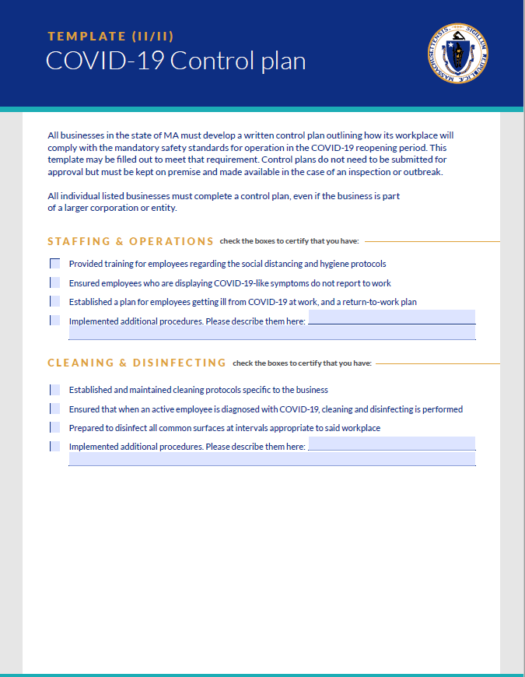
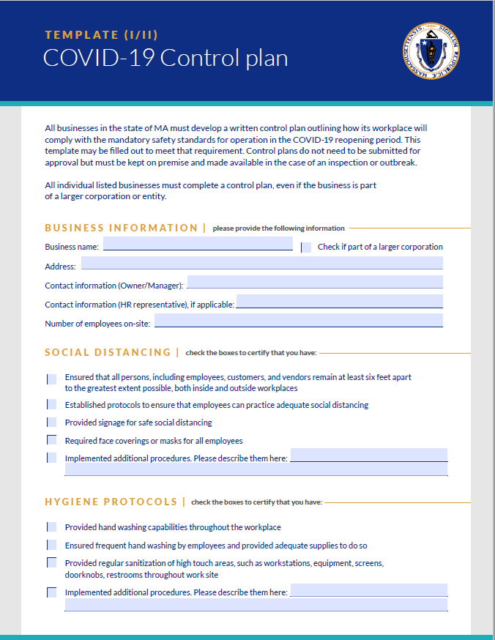
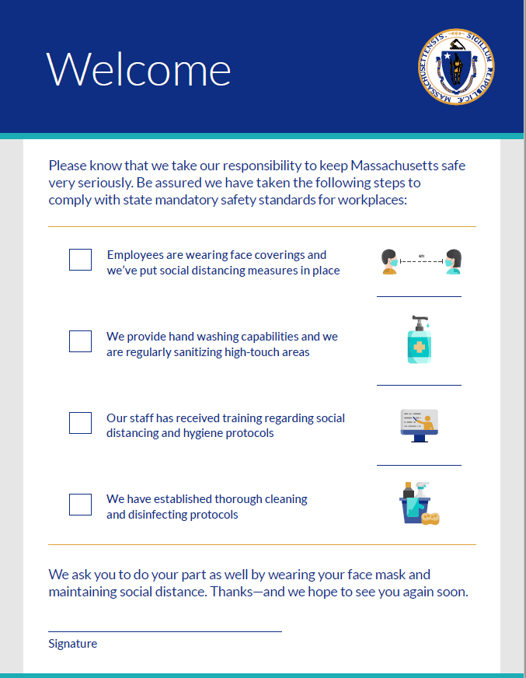
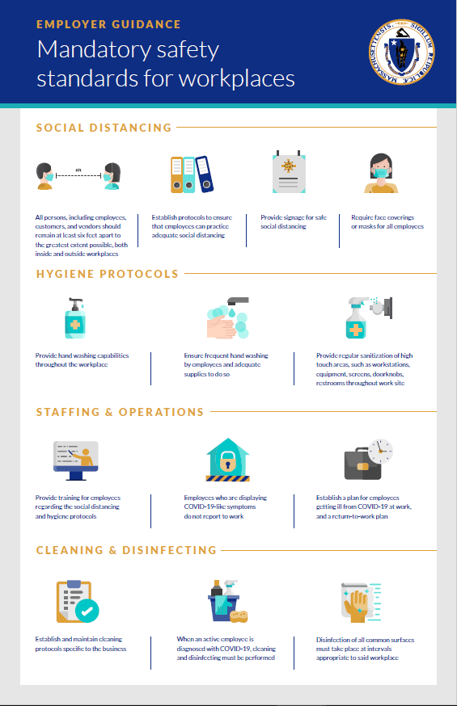
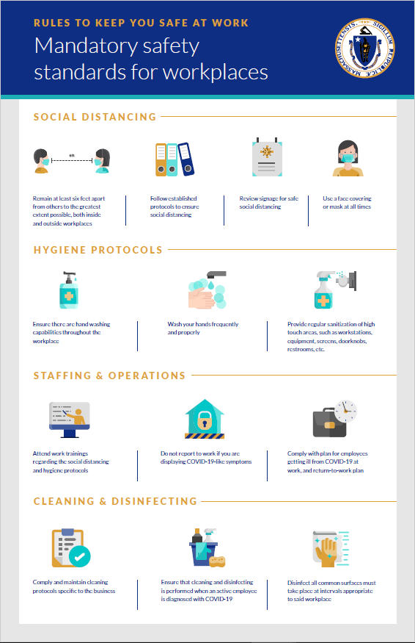
REOPENING: PHASE 1 – START
Mandatory self-certification for businesses
In order to reopen, businesses must develop a written COVID-19 Control Plan outlining how its workplace will prevent the spread of COVID-19. Required Materials are located on mass.gov/reopening, and include:
COVID-19 control plan template
Businesses may complete a template, available on the mass.gov/reopening, to fulfill this requirement. This plan does not need to be submitted to a state agency for approval, but must be retained on the premises of the business and be provided in the event of an inspection.
Compliance attestation poster
Businesses are required to sign a poster, attesting that they have completed a COVID-19 control plan, and post it in an area within the business premises that is visible to employees and visitors.
Other posters
Businesses are required to post signs and posters describing the rules for maintaining social distancing, hygiene protocols, cleaning, and disinfecting.
Employer
Worker
Note: All reopening businesses must meet these requirements before reopening. Businesses that are designated as essential may remain open but are required to complete these steps by May 25, 2020.
REOPENING MASSACHUSETTS

Slide 20
CARING FOR CHILDREN
The Commonwealth's mission in reopening is to increase access to childcare and youth programs, protect children and staff, and reduce the spread of COVID-19. Child care and summer recreation camps will reopen in a phased approach. The Departments of Early Education and Care and Public Health are developing guidelines that balance families' need for child care with heath and safety. The initial reopening plan will focus on families who have no safe alternative to group care by increasing emergency child care capacity. EEC will also partner with industries returning to work to develop options specific to their workplaces.
Since March, emergency child care has been available to children of workers, with extra virus mitigation protocols
Going forward, we are continuing to tailor strategies to ensure safe child care and recreational summer camp options for Massachusetts families
Childcare operating at reduced capacity and on an emergency basis for children of workers with no safe alternative to group care during Phase 1.
Implemented virus mitigation protocols including social distancing, cleaning and disinfecting, group ratio changes, isolation and contact tracing protocols, and extra staffing.
We continually solicit feedback from providers about operational support needed to reopen.
Prioritizing safe child care options for workers with no safe alternative to group care. Leveraging and building capacity across the emergency child care system.
Partnering with industries returning to work as part of this reopening plan to ensure responsive, innovative options targeted to specific workplaces.
Opening on a phased basis recreational day camps in Phase 2 and residential camps in Phase 3.
Releasing detailed guidelines in the coming weeks.
REOPENING MASSACHUSETTS

Slide 21
TRANSIT (I)
The MBTA has been and will continue to implement measures to slow the spread of COVID-19 across the system to keep employees and riders safer.
While public transportation unavoidably creates some risk of transmission, the MBTA, riders and employers can significantly reduce that risk by working together:
Riders are required to wear masks and must make efforts to distance. Riders are asked to avoid riding transit if they are exhibiting symptoms of COVID-19.
Employers are encouraged to stagger schedules and implement work from home policies to reduce demand, especially during rush hours.
The MBTA will continue to take protective and preventative measures such as frequently disinfecting and cleaning vehicles and stations and providing protective supplies to workers.
To mitigate risk while providing appropriate levels of service, the MBTA will:
Support the transit needs of essential workers and those returning to the workplace in Phase 1 while continuing with limited service to maximize employee and rider safety.
Ramp up to a modified version of full service by Phase 3, although social distancing efforts will limit effective capacity on vehicles even after full service schedules are restored.
Actively communicate public health guidance and schedule adjustments in-station, online, and over social media.
REOPENING MASSACHUSETTS

Slide 22
TRANSIT (II)
Current state:
Stay at home
Phase 1: Start
Phase 2: Cautious
Phase 3: Vigilant
Phase 4: New normal
Bus
Adapted Saturday schedule
Unchanged
Additional service for high demand bus routes as staffing permits
Resume full 2020 schedule, as staffing permits. Add service to high demand routes
Resume FY20 full schedule/ possible peak addition**
Subway / Blue
Adapted Saturday schedule
Unchanged
FY20 full schedule
FY20 full schedule
FY20 full schedule
Subway/ Red
Saturday schedule
Unchanged
Increased service (shorter time between trains)
FY 20 full schedule
FY20 full schedule
Subway/ Orange
Saturday schedule
Unchanged
Increased service (shorter time between trains)
FY 20 full schedule
FY20 full schedule
Green Line
Saturday schedule
Unchanged
Increased service (shorter time between trains)
FY20 full schedule as staffing permits
FY20 full schedule
Commuter Rail
Reduced schedule
Unchanged
Additional trains including off-peak on Fairmount Line
Modified FY20 full schedule*
Modified FY20 full schedule*
Ferries
Closed
Unchanged
Reopen with reduced service
FY20 full schedule
FY20 full schedule
Degree of certainty given the progression of COVID-19
Most certain
Least certain
* FY20 schedule modified, where feasible, to reflect changed travel patterns in COVID-19 new normal and workforce availability
** MBTA has 60 buses on order so possible peak additions could add those buses to schedule, dependent on workforce availability
REOPENING MASSACHUSETTS

Slide 23

HYGIENIC AND PROTECTIVE SUPPLIES
In order to operate, all Massachusetts businesses will need to meet the Mandatory Workplace Safety Standards and relevant Sector-Specific Protocols published by the state.
The state has developed a guide to educate business owners on what supplies are needed to return to workplaces, and a portal to connect businesses with manufacturers and distributors.
Educational materials will be provided to define
how an employer should prepare their work spaces to reopen and what products are appropriate for employees to protect themselves at work. Medical grade face coverings are not necessary for non-health care workers
A searchable portal has been launched to connect Massachusetts businesses in need of supplies with manufacturers whom are actively producing and selling hygienic and protective materials in the Commonwealth
Guidance on protective supplies, including, but not limited to:
  What can be used as a face covering and how to wear it safely
  When are gloves necessary for employees, and how to wash your hands
Disinfecting and sanitizing guidance and which materials to use, including, but not limited to:
  Disinfecting wipes/spray
  Sanitizing wipes/spray
  Hand sanitizer
Contact and product information for vendors who have or have had a contract with the Commonwealth.
Contract and product information for manufacturers that have pivoted to produce hygienic or protective supplies as part of the
M-ERT process.
Manufacturing Emergency Response Team
430+
Massachusetts manufacturers
27
Graduated M-ERT companies
3.5
Million pieces of PPE to date
Access supply vendors on mass.gov/reopening
REOPENING MASSACHUSETTS

Slide 24
K-12 SCHOOLS
As previously announced, Massachusetts' K-12 school buildings will remain closed through the end of the 2019-20 school year, with remote teaching and learning in place. Schools will continue offering essential non-educational services to their communities. Plans are being made for the summer learning programs and 2020-21 school year and will be shared with the public in the weeks to come.
K-12 school buildings will remain closed through the end of the 2019-20 school year
Potential for limited exceptions to be announced at a later date.
Remote teaching and learning should continue through the end of the 2019-20 school year
As previously announced.
Schools should continue offering essential non-educational services
Examples include take-out and food delivery to students and families.
Plans for the summer and 2020-21 school year are being developed and will be announced soon
We are developing plans for summer learning programs and the next school year and closely tracing the progression of the virus as part of the reopening process.
REOPENING MASSACHUSETTS

Slide 25
HIGHER EDUCATION
Massachusetts' diverse higher education institutions continue to foster teaching, learning, student support, and essential research remotely throughout this time. They are working together and in partnership with the state to ensure a safe and gradual return to campus life. In the upcoming weeks, institutions will develop customized reopening plans to ensure the safety of their communities.
Four key principles will guide the return to campus life for Massachusetts' higher education institutions
Institutions will craft their own campus reopening plans for each phase, to be implemented once common key enablers are met
Protect the health and safety of students, faculty, staff and people in surrounding communities.
Enable students to make meaningful progress towards their educational goals.
Contribute to research and innovation.
Minimize adverse economic impact on families, employees and the Massachusetts economy.
In all phases: Safety guidelines and health monitoring protocols will be implemented throughout all elements of campus life – including classrooms, housing, dining, facilities and services.
In Phase 1: Higher education institutions can repopulate research laboratories and medical, dental, veterinary and allied health clinical education and services, and restart functions necessary to prepare campuses to reopen. All activities must observe applicable social distance guidance.
In Phases 2 and 3: Following public health guidance, each institution will develop its own plans for course delivery which will likely involve a combination of in-person and remote learning in order to allow for social distancing on campus.
REOPENING MASSACHUSETTS

Slide 26
For more information:
www.mass.gov/reopening
  More detailed information on businesses, services, and activities that will open in each phase
  Resources for employers and employees
    Mandatory Workplace Safety Standards
    Sector-Specific Protocols and best practices
    Template COVID-19 control plans and workplace posters
  Copies of this presentation, as well as additional information about the Reopening Advisory Board
REOPENING MASSACHUSETTS

Slide 27
THANK YOU
We'd like to thank the Reopening Advisory Board and the numerous other stakeholders for their input in developing this report
Reopening Advisory Board:
Co-Chairs:
  Karyn Polito – Lieutenant Governor
  Mike Kennealy – Secretary, Executive Office of Housing and Economic Development
Members:
  Aron Ain – CEO, Kronos Inc & Ultimate Software
  Joe Bahena – Senior Vice President, Joseph Abboud Manufacturing
  Monica Bharel MD, MPH – Commissioner of the Massachusetts Department of Public Health
  Kathryn Burton – Chief of Staff, City of Boston
  Steve DiFillippo – CEO, Davio's Restaurants
  Pamela Everhart – Head of Regional Public Affairs and Community Relations, Fidelity Investments
  Wendy Hudson – Owner, Nantucket Book Partners / Co-Founder, Cisco Brewers
  Mark Keroack – MD, MPH, President & CEO, Baystate Health
  Nicole LaChapelle – Mayor, City of Easthampton
  Laurie Leshin – Ph.D., President, Worcester Polytechnic Institute
  Linda Markham - President, Cape Air
  Girish Navani – CEO and Co-Founder, eClinicalWorks
  Stephanie Pollack – Secretary of Transportation
  Daniel Rivera – Mayor, City of Lawrence
  Corey Thomas – CEO, Rapid 7
  Rochelle Walensky – MD, MPH, Massachusetts General Hospital
  Carlo Zaffanella – Vice President and General Manager, Maritime & Strategic Systems, General Dynamics Mission Systems
REOPENING MASSACHUSETTS

Slide 28
OTHER RESOURCES
COVID-19 Updates and Information –
https://www.mass.gov/info-details/covid-19-updates-and-information
COVID-19 Prevention and Treatment –
https://www.mass.gov/info-details/covid-19-prevention-and-treatment
COVID-19 Resources and Guidance for Businesses –
https://www.mass.gov/info-details/covid-19-resources-and-guidance-for-businesses
COVID-19 Response Reporting –
https://www.mass.gov/info-details/covid-19-response-reporting
Guidance: Wear a Mask In Public (Issued May 1, 2020) –
https://www.mass.gov/news/wear-a-mask-in-public
Mandatory Workplace Safety Standards –
https://www.mass.gov/info-details/reopening-mandatory-safety-standards-for-workplaces
Travel Information Related to COVID-19 –
https://www.mass.gov/info-details/travel-information-related-to-covid-19#travel-to-massachusetts-
Cover Photo Credits –
George Headley, Laurie Turner, Joshua Qualls and David Mark via Pixabay
REOPENING MASSACHUSETTS

